Slide 1


Python + IOT
Course 8
Ver. 01
Copyright @ 2018 Innovaker

Slide 2


Course 7 Summary
. Basic concept of electric circuit
. What is photoresistor?
. What is laser pointer?
. Demo project --- photoresistor project 1
. What is 5G?
2
Copyright @ 2018 Innovaker

Slide 3
quick review basic concept of Electricity
Electricity is the movement of electrons. Electrons create charge, which we can harness to do work. Your lightbulb, your stereo, your phone, etc., are all harnessing the movement of the electrons in order to do work. They all operate using the same basic power source: the movement of electrons.
The three basic principles for this tutorial can be explained using electrons, or more specifically, the charge they create:
Voltage is the difference in charge between two points.
Current is the rate at which charge is flowing.
Resistance is a material’s tendency to resist the flow of charge (current).
3
Copyright @ 2018 Innovaker
Notes:
Teacher notes:
Electricity is a natural phenomenon that occurs throughout nature and takes many different forms. In this tutorial we’ll focus on current electricity: the stuff that powers our electronic gadgets. Our goal is NOT to understand how electricity flows from a power source through wires, lighting up LEDs, spinning motors, and powering our communication devices.
Electricity is briefly defined as the flow of electric charge, but there’s so much behind that simple statement. Where do the charges come from? How do we move them? Where do they move to? How does an electric charge cause mechanical motion or make things light up? So many questions! To begin to explain what electricity is we need to zoom way in, beyond the matter and molecules, to the atoms that make up everything we interact with in life.
We do not have time to discuss and explain all of those concepts in this class, instead, we will focus on the electric circuit, and how its basic concept, and how it works.

Slide 4
What is Innovaker Digital Circuits Kits
Innovaker Digital Circuits Kit, is a special designed STEM kits. Using these tools from the kits, students can focus on electronic theory and programming instead of spending time making tedious wire connections. By undertaking a series of hands-on projects, students will learn how to develop rapid prototypes safely.
Innovaker Digital Circuits Kit includes:
. Pi PCB
. LED
. Resistor
. LCD
. Relay
. Buzzer
. Motion sensor
. Light sensor
. Button with cap
. 1uf Capacitor
. Temperature & Humidity Sensor
. Arduino Nano
4
Copyright @ 2018 Innovaker

Slide 5
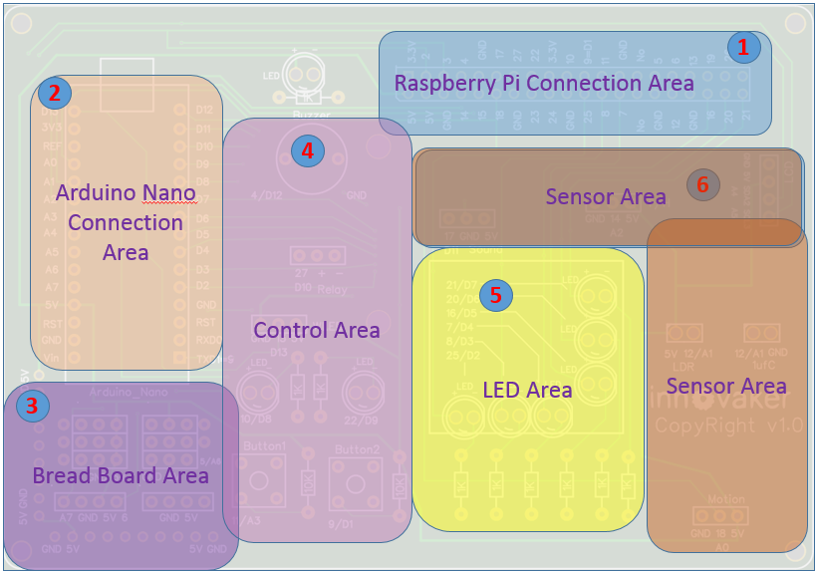
Innovaker Digital Circuits Kits layout
Innovaker Digital Circuits Kit, is a special designed STEM kits. It has built in Arduino Nano, and can connect to external Raspberry Pi.
5
Copyright @ 2018 Innovaker

Slide 6

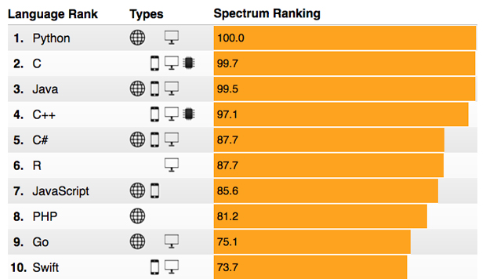
Raspberry Pi
remote access
option 2
Use network cable to connect with router to get IP
Connect Pi with router with ethernet cable, start Pi, the IP will be displayed on LCD, then remote connect to Raspberry Pi through VNC viewer.
Option 1: use monitor / keyboard / mouse to connect to wifi (see previous slide)
Copyright @ 2018 Innovaker
Notes:
IP address
Get Pi IP address is one important step to use Pi with laptop or other computer.
If IP address for example as “192.168.0.15” is displayed on LCD, go to chapter VNC.
Here is workflow how to get wifi IP address:
If there is no IP address is displayed on LCD, there are three ways to get IP.
Use monitor / keyboard / mouse to connect to wifi
Use network cable to connect with router to get IP
Use smartphone hotspot to get IP
Following chapter will introduce above IP methods.
Innovaker Kits special feature (not come with Raspbian)
Option 2: Use network cable to connect with router to get IP
Connect Pi with router with ethernet cable, start Pi, the IP will be displayed on LCD, go to VNC chapter to setup Wifi or use directly.

Slide 7
Raspberry Pi
remote access
option 3
Use martphone hotspot to get IP
Set hotspot on smartphone,
the spot name “Pizhi”, password “innovaker”.
Start Pi with LCD, the LCD will display Pi IP of hotspot, go to VNC, then remote connect to Raspberry Pi through VNC viewer.
Option 1: use monitor / keyboard / mouse to connect to wifi (see previous slide)
Copyright @ 2018 Innovaker
Notes:
Innovaker Kits special feature (not come with Raspbian)
Option 3: Use martphone hotspot to get IP
Set hotspot on smartphone, the spot name “Pizhi”, password “innovaker”.
Start Pi with LCD, the LCD will display Pi IP of hotspot, go to VNC.

Slide 8
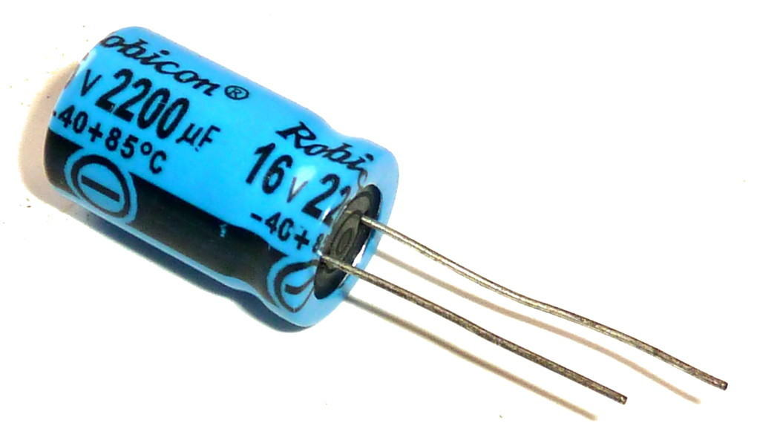
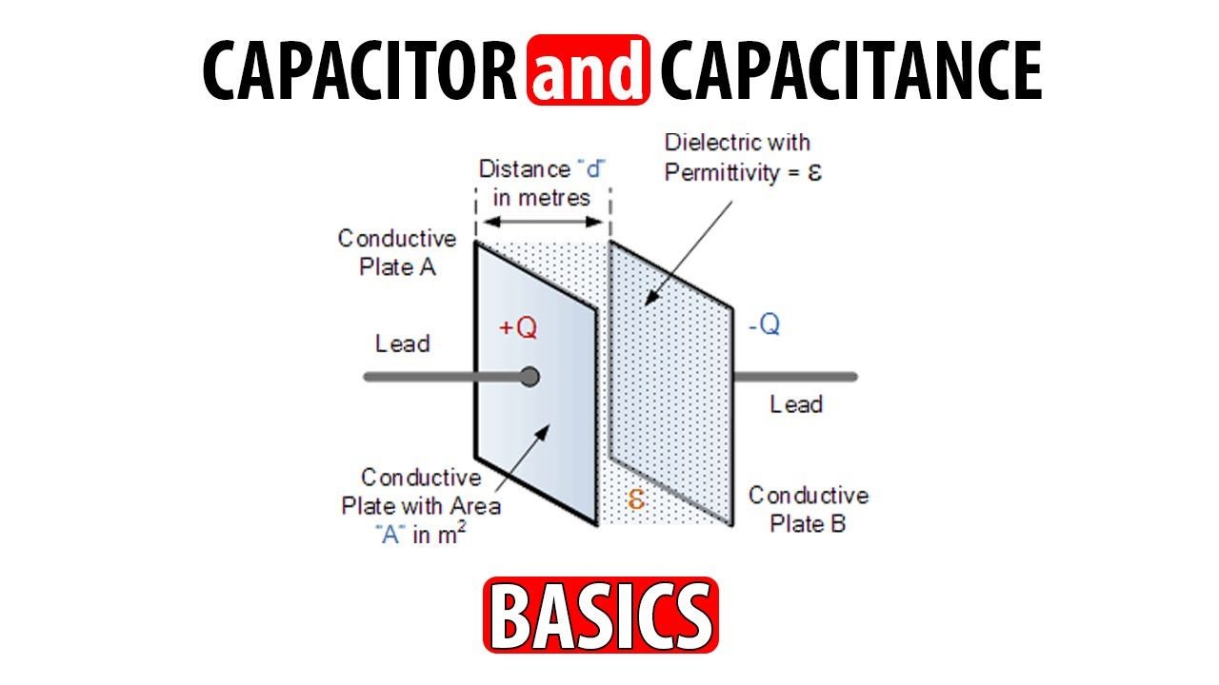
Electronic
component
--- capacitor
capacitor
A capacitor is a passive two-terminal electrical component that stores potential energy in an electric field. The effect of a capacitor is known as capacitance. While some capacitance exists between any two electrical conductors in proximity in a circuit, a capacitor is a component designed to add capacitance to a circuit.
How does it work?
a capacitor works like a tiny rechargeable battery with very low capacity. A capacitor is made up of two metallic plates. With a dielectric material in between the plates.
When you apply a voltage over the two plates, an electric field is created. Positive charge will collect on one plate and negative charge on the other.
Copyright @ 2018 Innovaker
Notes:
Teacher notes:
Take two electrical conductors (things that let electricity flow through them) and separate them with an insulator (a material that doesn't let electricity flow very well) and you make a capacitor: something that can store electrical energy. Adding electrical energy to a capacitor is called charging; releasing the energy from a capacitor is known as discharging.
A capacitor is a bit like a battery, but it has a different job to do. A battery uses chemicals to store electrical energy and release it very slowly through a circuit; sometimes (in the case of a quartz watch) it can take several years. A capacitor generally releases its energy much more rapidly—often in seconds or less. If you're taking a flash photograph, for example, you need your camera to produce a huge burst of light in a fraction of a second. A capacitor attached to the flash gun charges up for a few seconds using energy from your camera's batteries. (It takes time to charge a capacitor and that's why you typically have to wait a little while.) Once the capacitor is fully charged, it can release all that energy in an instant through the xenon flash bulb. Zap!
Capacitors come in all shapes and sizes, but they usually have the same basic components. There are the two conductors (known as plates, largely for historic reasons) and there's the insulator in between them (called the dielectric). The two plates inside a capacitor are wired to two electrical connections on the outside called terminals, which are like thin metal legs you can hook into an electric circuit.
The amount of electrical energy a capacitor can store is called its capacitance. The capacitance of a capacitor is a bit like the size of a bucket: the bigger the bucket, the more water it can store; the bigger the capacitance, the more electricity a capacitor can store. There are three ways to increase the capacitance of a capacitor. One is to increase the size of the plates. Another is to move the plates closer together. The third way is to make the dielectric as good an insulator as possible. Capacitors use dielectrics made from all sorts of materials. In transistor radios, the tuning is carried out by a large variable capacitor that has nothing but air between its plates. In most electronic circuits, the capacitors are sealed components with dielectrics made of ceramics such as mica and glass, paper soaked in oil, or plastics such as mylar.

Slide 9
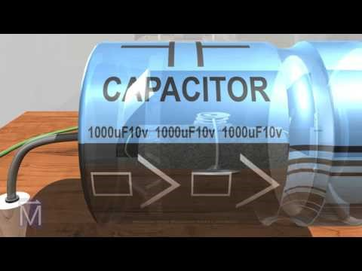
Electronic
component
--- capacitor
Copyright @ 2018 Innovaker
Notes:
Teacher notes:
Take two electrical conductors (things that let electricity flow through them) and separate them with an insulator (a material that doesn't let electricity flow very well) and you make a capacitor: something that can store electrical energy. Adding electrical energy to a capacitor is called charging; releasing the energy from a capacitor is known as discharging.
A capacitor is a bit like a battery, but it has a different job to do. A battery uses chemicals to store electrical energy and release it very slowly through a circuit; sometimes (in the case of a quartz watch) it can take several years. A capacitor generally releases its energy much more rapidly—often in seconds or less. If you're taking a flash photograph, for example, you need your camera to produce a huge burst of light in a fraction of a second. A capacitor attached to the flash gun charges up for a few seconds using energy from your camera's batteries. (It takes time to charge a capacitor and that's why you typically have to wait a little while.) Once the capacitor is fully charged, it can release all that energy in an instant through the xenon flash bulb. Zap!
Capacitors come in all shapes and sizes, but they usually have the same basic components. There are the two conductors (known as plates, largely for historic reasons) and there's the insulator in between them (called the dielectric). The two plates inside a capacitor are wired to two electrical connections on the outside called terminals, which are like thin metal legs you can hook into an electric circuit.
The amount of electrical energy a capacitor can store is called its capacitance. The capacitance of a capacitor is a bit like the size of a bucket: the bigger the bucket, the more water it can store; the bigger the capacitance, the more electricity a capacitor can store. There are three ways to increase the capacitance of a capacitor. One is to increase the size of the plates. Another is to move the plates closer together. The third way is to make the dielectric as good an insulator as possible. Capacitors use dielectrics made from all sorts of materials. In transistor radios, the tuning is carried out by a large variable capacitor that has nothing but air between its plates. In most electronic circuits, the capacitors are sealed components with dielectrics made of ceramics such as mica and glass, paper soaked in oil, or plastics such as mylar.

Slide 10
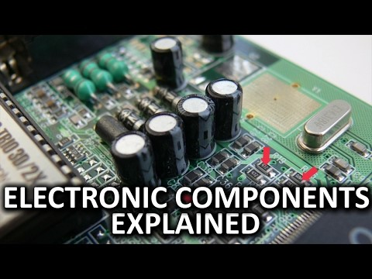
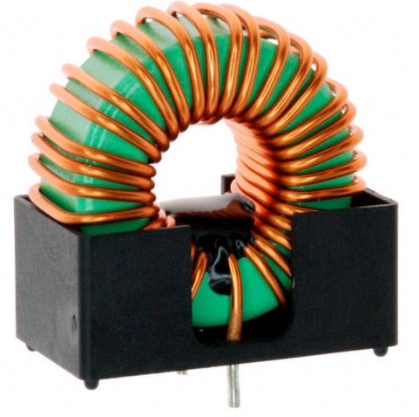
Electronic
component
--- capacitor vs.
resistor vs. inductor
Copyright @ 2018 Innovaker
Notes:
Teacher notes:
Difference between Capacitor and Inductor
Capacitor Uses
High Voltage Electrolytic capacitor is used in power supplies.
An Axial Electrolytic capacitor is used in lower voltage smaller size for general purpose where huge capacitance principles are needed.
High Voltage disk ceramic capacitor is a small size & the value of capacitance and excellent tolerance characteristics.
The Metalised Polypropylene capacitor is a small size for values up to 2µF and good reliability.
Surface mount capacitor is relatively high capacitance for size attained by several layers. In fact, numerous capacitors in parallel.
Inductor Uses
Inductors are extensively used in AC applications like TV, radio, etc.
Chokes – The main property of an inductor is used in power supply circuits where AC mains supply desires to be changed to a DC supply.
Energy store – It is used to make the spark that catch fires the petrol in automobile engines.
Transformers– Inductors with a distributing magnetic lane can be united to form a transformer.

Slide 11
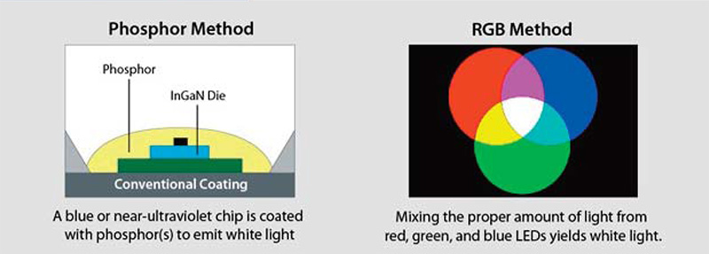
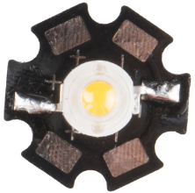
Electronic
component
--- WLED
WLED
WLED stands for white light-emitting diode. This technology is a common source of backlighting for digital monitors, and display manufacturers use the terms WLED and LED interchangeably.
Copyright @ 2018 Innovaker
Notes:
Teacher notes:
Do you know the scientist who invent blue LED win Nobel prize
The 2014 Nobel Prize for physics has been awarded to a trio of scientists in Japan and the US for the invention of blue light emitting diodes (LEDs). Professors Isamu Akasaki, Hiroshi Amano and Shuji Nakamura made the first blue LEDs in the early 1990s.
Blue-light innovation paved the way for a transformation in lighting efficiency.
Red and green diodes had been around for several years, but adding blue diodes allowed a mix that could produce practical white-light LED bulbs.
LEDs use less energy than do other forms of lighting, including compact fluorescent (CFL) and incandescent bulbs. A typical LED bulb can produce around 83 lumens per watt—a measure of how much brightness you can get from a unit of electrical power—compared with 67 for a comparable CFL bulb and 16 for an incandescent.
LEDs produce light by passing electric current through a semiconductor, whereas incandescent bulbs pass current through a wire filament until it glows from the heat. The wasted heat energy is chiefly why incandescent bulbs are so much less efficient. Most varieties of the incandescent light bulb have been phased out in the United States. (Related: "U.S. Phase-Out of Incandescent Bulbs Continues in 2014.")
LEDs also last about 30 times longer than incandescent bulbs do, according to the Energy Information Administration, and many LED bulb products promise up to 25,000 hours of use—more than 17 years if you used one for about four hours a day.

Slide 12


Electronic
component
--- WLED
Copyright @ 2018 Innovaker
Notes:
Teacher notes:
In brief, there are two methods of creating "white light" using LED devices and each method offers differing efficiencies and effects. The first is described by the manufacturing method called phosphor on die and the other by the effects method of mixing the three primary colours of red, green and blue to create white light.

Slide 13
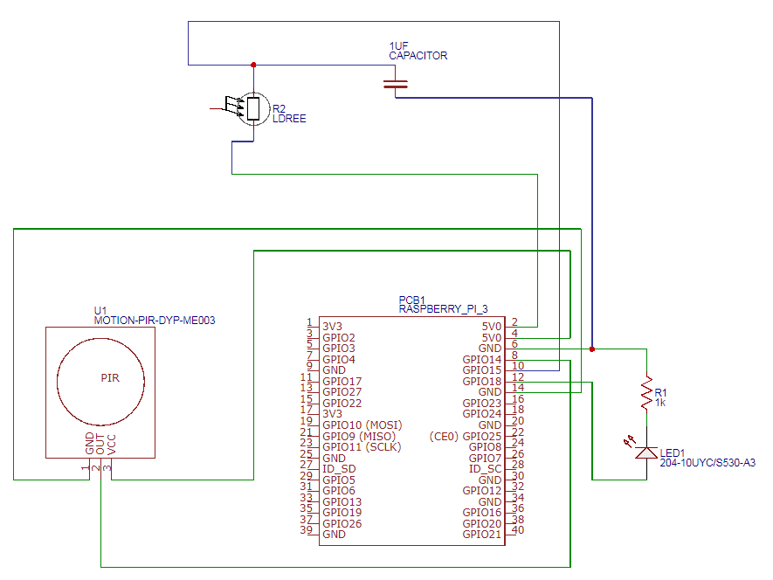
WLED diagram
Copyright @ 2018 Innovaker
Notes:
Teacher notes:

Slide 14
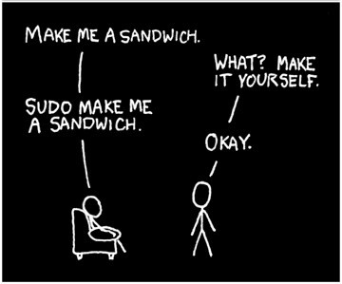
Demo Project
WLED I
#!/bin/sh #06.wled.sh # this is the script to # launch the 06.wled.py sudo python 06.wled.py
# without SUDO, it will require the root # user to run and load all the script and # library
Copyright @ 2018 Innovaker
Notes:
Teacher notes:
'sudo' allows you to run something as if you were somebody else. Typically it is used to run something as the 'root' user. The root user can do anything, good or bad, without question. If you erroneously run something as root then realize your mistake, you may find your program does not work - even if it would have done had you not run it as root in the first place.

Slide 15


Demo Project
WLED I
Copyright @ 2018 Innovaker
Notes:
Teacher notes:
https://www.youtube.com/watch?v=OwIhgpOaHEA&index=78&list=PLgvNLj_3MWFef88q0iBRCqbwjNfeDgaCU
A fresh install of Raspbian on a Raspberry Pi allows you to log in using the username pi and password raspberry. Using sudo will enable you to issue rootcommands, with which you can do or install anything. You don't need to enter apassword to use sudo as the root password is disabled by default.
'sudo' allows you to run something as if you were somebody else. Typically it is used to run something as the 'root' user. The root user can do anything, good or bad, without question. If you erroneously run something as root then realize your mistake, you may find your program does not work - even if it would have done had you not run it as root in the first place.

Slide 16
Demo Project
WLED library
Challenge and
Solution for
Neopixel LED
NeoPixels, and the WS2811/2812 LEDs require a data signal with very specific timing to work correctly.
Because the Raspberry Pi runs a multi-tasking Linux operating system it doesn't have real-time control over its GPIO pins and can't easily drive NeoPixels.
Typically a small microcontroller like a Trinket or Teensy can be used to communicate with the Raspberry Pi and generate the NeoPixel data signal.
However thanks to the excellent rpi_ws281x library created by Jeremy Garff, you can now control NeoPixels or WS2811/WS2812 LEDs directly from your Raspberry Pi!
Jeremy's library solves the real-time control problem by using the PWM and DMA hardware on the Raspberry Pi's processor.
The great thing about Jeremy's library is that it does all the hard work of setting up PWM and DMA to drive NeoPixels. On top of rpi_ws281x I've added a small Python wrapper which makes the library look and feel like the Arduino NeoPixel library.
Copyright @ 2018 Innovaker
Notes:
Teacher notes:
https://www.youtube.com/watch?v=OwIhgpOaHEA&index=78&list=PLgvNLj_3MWFef88q0iBRCqbwjNfeDgaCU
A fresh install of Raspbian on a Raspberry Pi allows you to log in using the username pi and password raspberry. Using sudo will enable you to issue rootcommands, with which you can do or install anything. You don't need to enter apassword to use sudo as the root password is disabled by default.
'sudo' allows you to run something as if you were somebody else. Typically it is used to run something as the 'root' user. The root user can do anything, good or bad, without question. If you erroneously run something as root then realize your mistake, you may find your program does not work - even if it would have done had you not run it as root in the first place.

Slide 17
Demo Project
WLED II
import time From neopixel import * import signal Import sys import argparse
# LED strip configuration: LED_COUNT = 16 LED_PIN = 13 LED_FREQ_HZ = 800000 LED_DMA = 5 LED_BRIGHTNESS = 255 LED_INVERT = False LED_CHANNEL = 1 LED_STRIP = ws.WS2811_STRIP_GRB | #number of LED pixels #GPIO pin connected to the pixels #LED signal frequency in hertz # DMA channel to use for signal (try 5) # set to 0 for darkest and 255 for brightnest #true to invert the signal #set to ‘1’ for GPIOs 13, 19, 41. 45. 53 # strip type and color ordering
def signal_handler(signal, frame): colorWipe(strip, Color(0,0,0)) sys.exit(0)
Copyright @ 2018 Innovaker
Notes:
Teacher notes:
NeoPixels, and the WS2811/2812 LEDs that make them up, require a data signal with very specific timing to work correctly. Because the Raspberry Pi runs a multi-tasking Linux operating system it doesn't have real-time control over its GPIO pins and can't easily drive NeoPixels.
Typically a small microcontroller like a Trinket or Teensy can be used to communicate with the Raspberry Pi and generate the NeoPixel data signal. However thanks to the excellent rpi_ws281x library created by Jeremy Garff, you can now control NeoPixels or WS2811/WS2812 LEDs directly from your Raspberry Pi!
Jeremy's library solves the real-time control problem by using the PWM and DMA hardware on the Raspberry Pi's processor. The PWM (pulse-width modulation) module can generate a signal with a specific duty cycle, for example to drive a servo or dim an LED. The DMA (direct memory access) module can transfer bytes of memory between parts of the processor without using the CPU. By using DMA to send a specific sequence of bytes to the PWM module, the NeoPixel data signal can be generated without being interrupted by the Raspberry Pi's operating system.

Slide 18
Demo Project
WLED III
def opt_parse(): parser = argparse.ArgumentParser() parser.add_argument(‘-c’, action=‘store_true’, help=‘clear the display on exit’) args = parser.parse_args() if args.c: signal.signal(signal.SIGHT, signal_handler) def colorWipe(strip, color, wait_ms=50): for i in range(strip.numPixels()): strip.setPixelColor(I, color) strip.show() time.sleep(wait_ms/1000.0) | #define functions which animate LEDS in various ways # wipe color across display a pixel at a time
Copyright @ 2018 Innovaker
Notes:
Teacher notes:

Slide 19
Demo Project
WLED III
def wheel(pos): if pos < 85: return Color(pos * 3, 255 - pos * 3, 0) elif pos < 170: pos -= 85 return Color(255 - pos * 3, 0, pos * 3) else: pos -= 170 return Color(0, pos * 3, 255 - pos * 3) def rainbow(strip, wait_ms=20, iterations=1): for j in range(256*iterations): for i in range(strip.numPixels()): strip.setPixelColor(i, wheel((i+j) & 255)) strip.show() time.sleep(wait_ms/1000.0) | """Generate rainbow colors across 0-255 positions.""" """Draw rainbow that fades across all pixels at once."""
Copyright @ 2018 Innovaker
Notes:
Teacher notes:

Slide 20
Demo Project
WLED III
def rainbowCycle(strip, wait_ms=20, iterations=5): for j in range(256*iterations): for i in range(strip.numPixels()): strip.setPixelColor(i, wheel((int(i * 256 / strip.numPixels()) + j) & 255)) strip.show() time.sleep(wait_ms/1000.0) def theaterChaseRainbow(strip, wait_ms=50): for j in range(256): for q in range(3): for i in range(0, strip.numPixels(), 3): strip.setPixelColor(i+q, wheel((i+j) % 255)) strip.show() time.sleep(wait_ms/1000.0) for i in range(0, strip.numPixels(), 3): strip.setPixelColor(i+q, 0) | """Draw rainbow that uniformly distributes itself across all pixels.""" """Rainbow movie theater light style chaser animation."""
Copyright @ 2018 Innovaker
Notes:
Teacher notes:

Slide 21
Demo Project
WLED III
if __name__ == '__main__': opt_parse() strip = Adafruit_NeoPixel(LED_COUNT, LED_PIN, LED_FREQ_HZ, LED_DMA, LED_INVERT, LED_BRIGHTNESS, LED_CHANNEL, LED_STRIP) strip.begin() print ('Press Ctrl-C to quit.') cloop=1 while True: | # Process arguments # Create NeoPixel object with appropriate configuration. # Intialize the library (must be called once before other functions).
Copyright @ 2018 Innovaker
Notes:
Teacher notes:

Slide 22
Demo Project
WLED III
print ('Color wipe animations.') colorWipe(strip, Color(255, 0, 0)) colorWipe(strip, Color(0, 255, 0)) colorWipe(strip, Color(0, 0, 255)) print ('Theater chase animations.') theaterChase(strip, Color(127, 127, 127)) theaterChase(strip, Color(127, 0, 0)) theaterChase(strip, Color( 0, 0, 127)) print ('Rainbow animations.') rainbow(strip) rainbowCycle(strip) theaterChaseRainbow(strip) cloop=cloop+1 # break | # Red wipe # blue wipe # green wipe # White theater chase # Red theater chase # Blue theater chase
Copyright @ 2018 Innovaker
Notes:
Teacher notes:

Slide 23
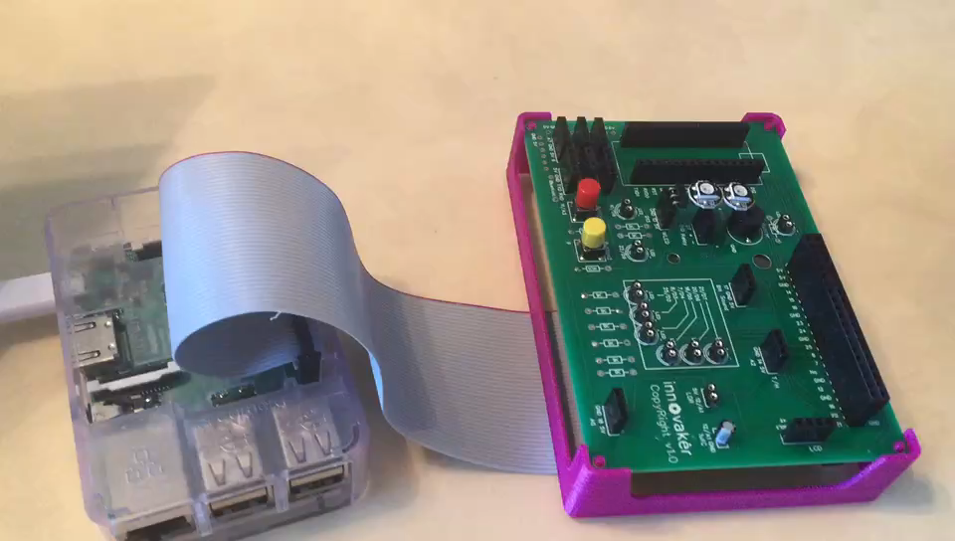
Demo Project
video demo
Copyright @ 2018 Innovaker
Notes:
Teacher notes:

Slide 24

Congratulations On Finishing
Copyright @ 2018 Innovaker

